Slide 1
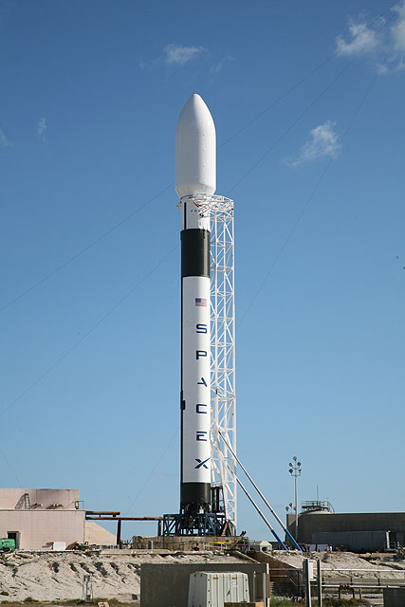

IBM Data Science Capstone Project
PRESENTED BY :M. Shashank

Slide 2
Project Overview
Objective
The objective of this project is to predict whether the first stage of a SpaceX Falcon 9 rocket will land successfully.
Why is this important?
Falcon 9 is a reusable launch vehicle.
Successful landings reduce launch costs.
Predicting landing success helps estimate the overall mission cost.
Data science techniques can improve decision-making using historical launch data.

Slide 3
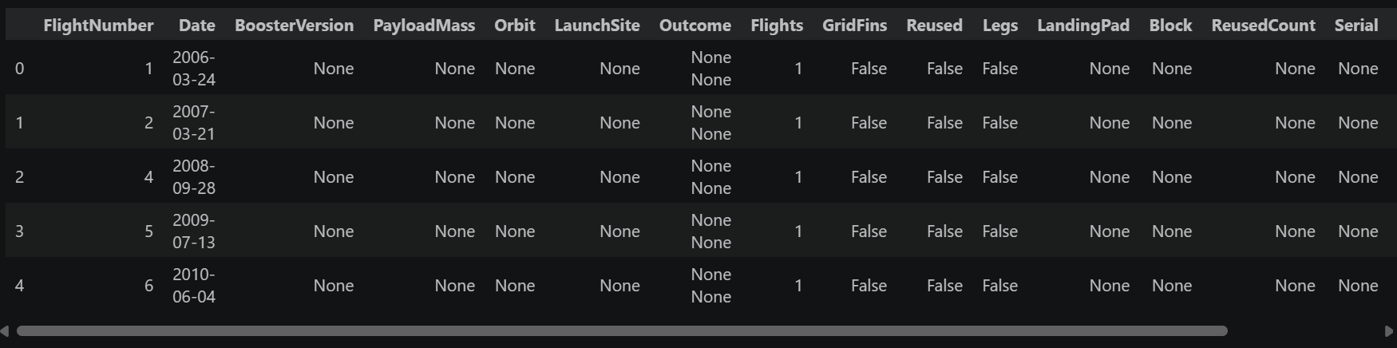
Data Collection
The launch data was collected from multiple sources:
SpaceX REST API
Wikipedia Web Scraping
Historical Falcon 9 launch records
Tools Used
Python
Requests
BeautifulSoup
Pandas

Slide 4
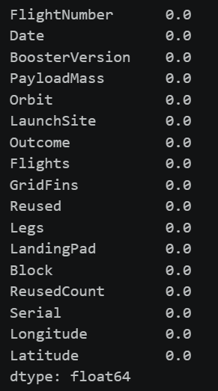
Data Wrangling
Data Wrangling
The collected data was cleaned and prepared before analysis.
Steps Performed
Removed Falcon 1 launches
Filtered only Falcon 9 launches
Handled missing values
Cleaned duplicate records
Prepared the dataset for analysis
Result
A clean and structured dataset was created for further analysis and machine learning.

Slide 5
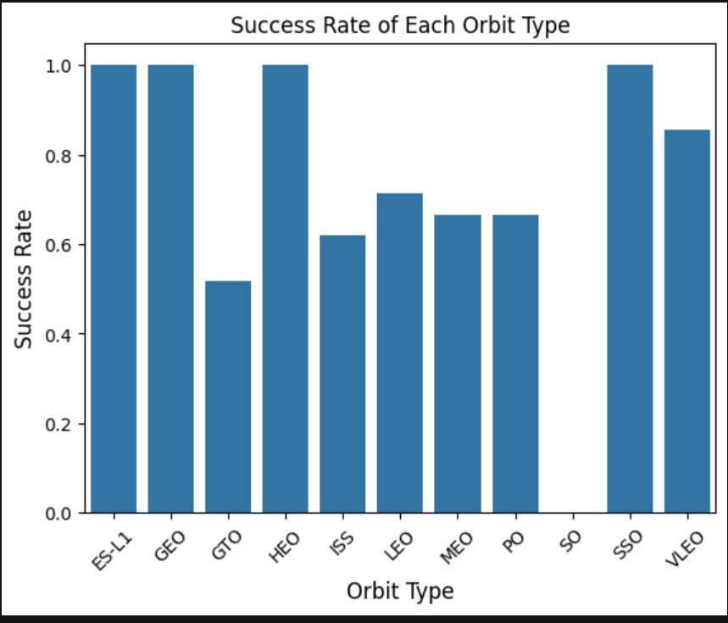
Exploratory Data Analysis (EDA)
Exploratory Data Analysis
Several factors affecting landing success were analyzed.
Analysis Performed
Payload Mass vs Landing Success
Flight Number vs Landing Success
Orbit vs Landing Success
Launch Site vs Landing Success
Observation
The analysis revealed patterns between launch characteristics and successful landings.

Slide 6
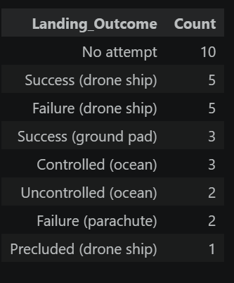
SQL Analysis
SQL Analysis
SQL was used to analyze the launch dataset.
Queries Performed
Total number of launches
Launches by site
Booster versions
Payload statistics
Successful missions
Result
SQL helped extract meaningful information from the dataset for further analysis.

Slide 7
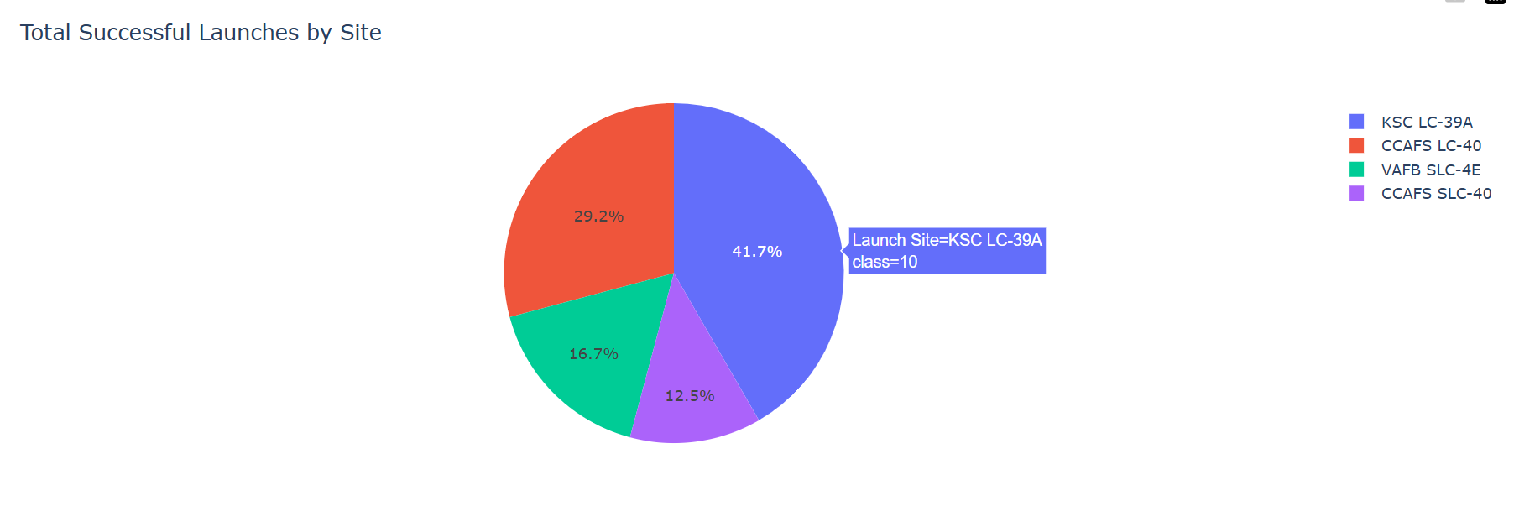
Interactive Dashboard
Interactive Dashboard
An interactive dashboard was developed to visualize launch information.
Dashboard Features
Launch Site Selection
Payload Range Slider
Pie Chart
Scatter Plot
Interactive Filtering
Benefit
The dashboard enables users to explore launch data visually and interactively.

Slide 8
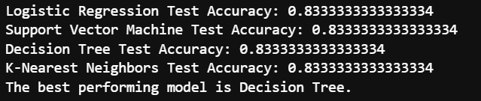
Machine Learning
Machine Learning Models
Several machine learning models were trained to predict landing success.
Models Used
Logistic Regression
Support Vector Machine (SVM)
Decision Tree
K-Nearest Neighbours (KNN)
Result
The models were evaluated using test accuracy, and the best-performing model was selected based on its performance.

Slide 9
Conclusion
Conclusion
Project Summary
Successfully collected SpaceX launch data.
Cleaned and prepared the dataset.
Performed exploratory data analysis.
Built an interactive dashboard.
Developed machine learning models to predict Falcon 9 landing success.
Future Scope
Improve prediction accuracy using more advanced machine learning models.
Include additional launch parameters.
Develop a real-time prediction system.

Slide 10
Thank You🙏
Questions?
IBM Data Science Capstone Project
Presented by: M. Shashank

